Slide 1

DEPARTMENT OF PHYSICS AND NANOTECHNOLOGY
SRM INSTITUTE OF SCIENCE AND TECHNOLOGY
18PYB103J –Semiconduuctor Physics
MODULE 5
S – 2
Introduction to Low dimensional systems
Quantum Well, Wire, Dot
1
18PYB101J Module-V Lecture-2

Slide 2

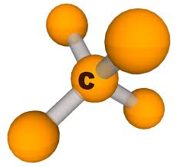

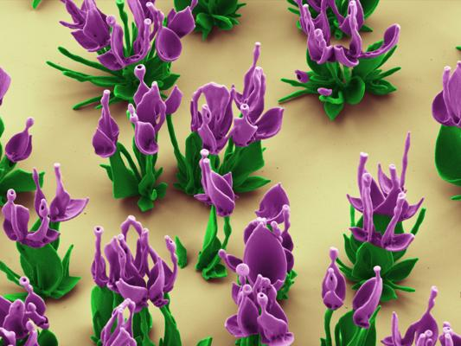
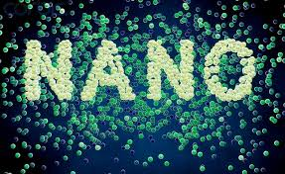
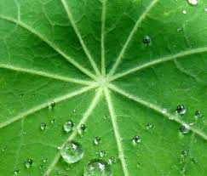
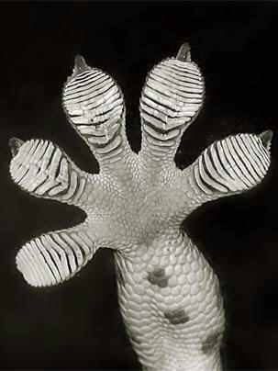
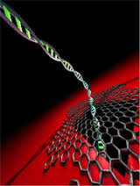
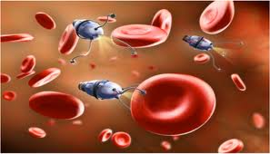
Nanoscience & Nanotechnology What is happening at a very, very small length scale?
18PYB101J Module-V Lecture-2

Slide 3
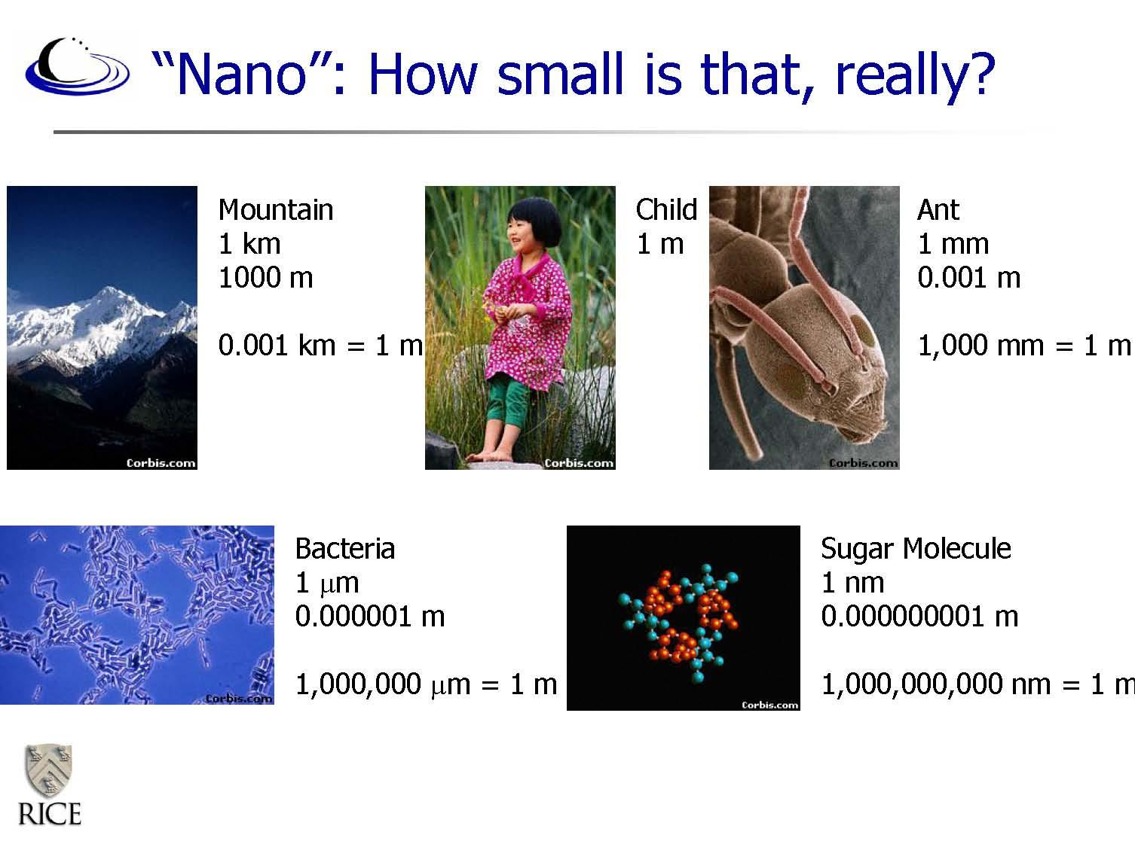
18PYB101J Module-V Lecture-2

Slide 4
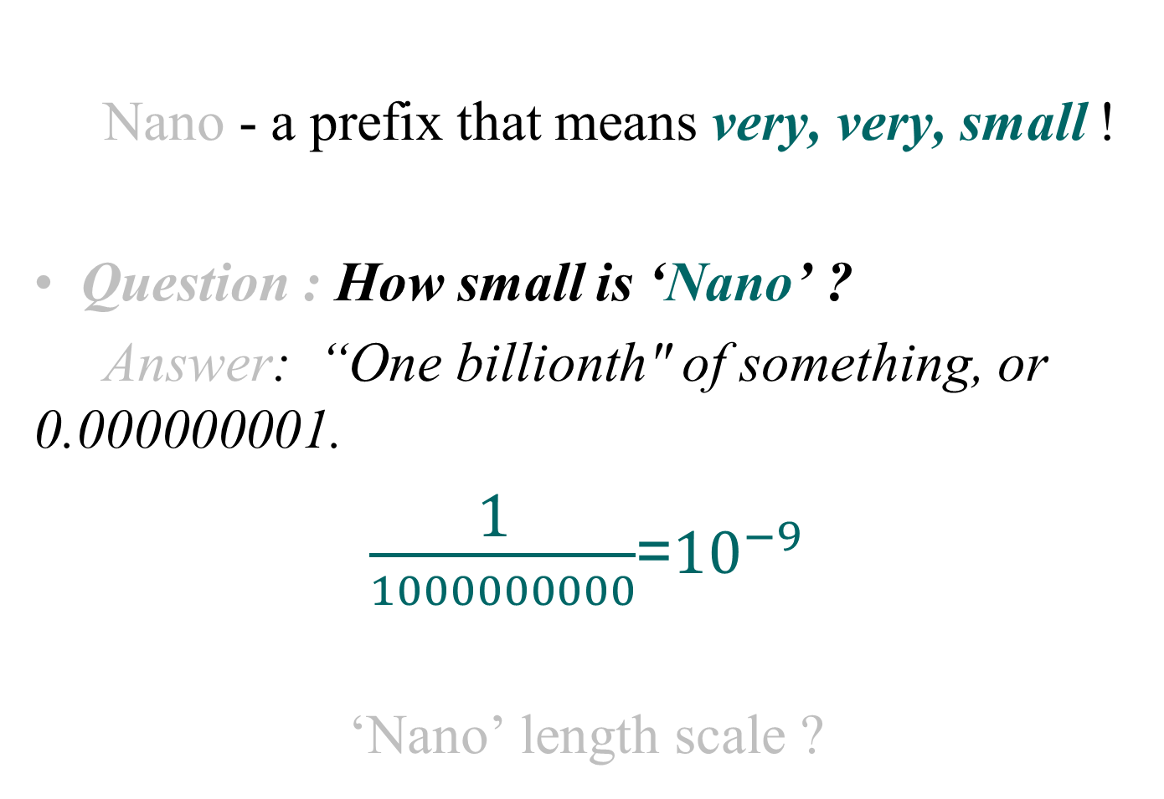
What is Nano ?
18PYB101J Module-V Lecture-2

Slide 5
Actual physical dimensions relevant to Nanosystem
Nanoscience
0.1nm 1nm 10nm 100nm 1μm 10 μm
Size and shape dependent
properties
Nanometer scale : The length scale where corresponding
property is size & shape dependent.

Slide 6
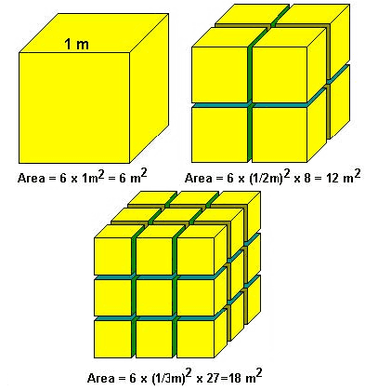
Surface to Volume Ratio Increases
As surface to volume ratio increases
A greater amount of a substance comes in contact with surrounding material.
This results in better catalysts, since a greater proportion of the material is exposed for potential reaction.

Slide 7
What’s interesting about the nanoscale?
Nano sized particles exhibit different properties than larger particles of the same substance.
Nano sized particle exhibit size & shape dependent properties.
How do properties change at the Nanoscale ?

Slide 8
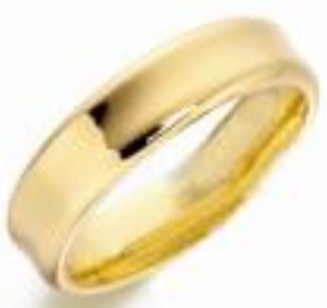
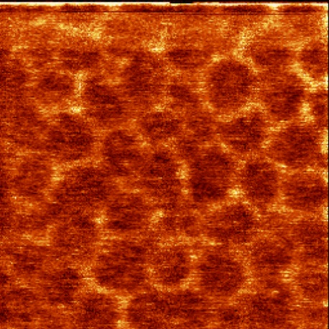
Optical Properties: Colour of Gold
Bulk gold
appears yellow in colour.
Nano sized gold
appears red in colour.
The particles are so small that electrons are not free to move about as in bulk gold Because this movement is restricted, the particles react differently with light.
12 nanometer gold clusters of particles look red.
Sources:
http://www.sharps-jewellers.co.uk/rings/images/bien-hccncsq5.jpg
http://www.foresight.org/Conferences/MNT7/Abstracts/Levi/

Slide 9
Nanoscience: Nanometer scale science
A part of science that studies small stuff
So, what is Nano science ?
It is not only Biology.
It is not only Physics .
It is not only Chemistry.
It is all sciences that work with the very small.
Nanoscience is not physics, chemistry, engineering or biology. It is all of them.
S.M. Lindsay, Introduction to Nanoscience,
Oxford University Press (2009).

Slide 10
Interdisciplinary
Physicists: physical forces between the individual atoms composing them – quantum effects Chemists : The interaction of different molecules is governed by chemical forces. Biologists : creation of small devices (encoding informations in DNA to perform multitasks Computer Scientists : Steady miniaturization : - Moore’s Law and its corollaries, the phenomena whereby the price performance, speed, and capacity of almost every component of the computer. Electrical Engineers : a steady supply of power. A control of electric signals is also vital to transistor switches and memory storage. Mechanical Engineers: nanolevel issues such as load bearing, wear, material fatigue, and lubrication

Slide 12
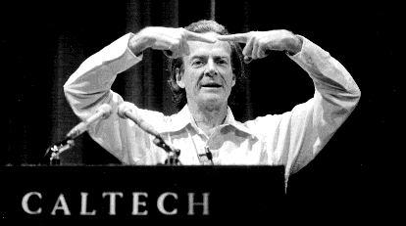
What makes the nanoscale special?
High density of structures is possible with small size.
Physical and chemical properties can be different at the nano-scale (e.g. electronic, optical, mechanical, thermal, chemical).
The physical behavior of material can be different in the nano-regime because of the different ways physical properties scale with dimension (e.g. area vs. volume).
Prof. Richard Feynman
“There’s plenty of room at the bottom”
*
12
Notes:
12

Slide 13

Dr. Richard P. Feynman
“Why cannot we write the entire 24 volumes of the Encyclopedia Britannica on the head of a pin?”
Dr. Richard Feynman, one of America’s most notable physicists, 1918-1988.
Figure 1.11: Richard Feynman.
12
Notes:
Brief History, Continued:
Dr. Richard P. Feynman:
The first well documented talk on the possibilities of nanotechnology was made by one of America’s most notable physicists, Richard Feynman (Zyvex, 2007). Dr. Feynman’s talk was called There Is Plenty of Room at the Bottom, and he delivered it on December 12, 1959, before the American Physical Society meeting held at Caltech. In his talk, Feynman challenged the scientific community to think small in terms of solving future problems. Feynman stated:
“Why cannot we write the entire 24 volumes of the Encyclopedia Britannica on the head of a pin?” (Zyvex, 2007).
Fig. 1.11 - http://en.wikipedia.org/wiki/Image:Feynman_and_Oppenheimer_at_Los_Alamos.jpg.
13

Slide 14
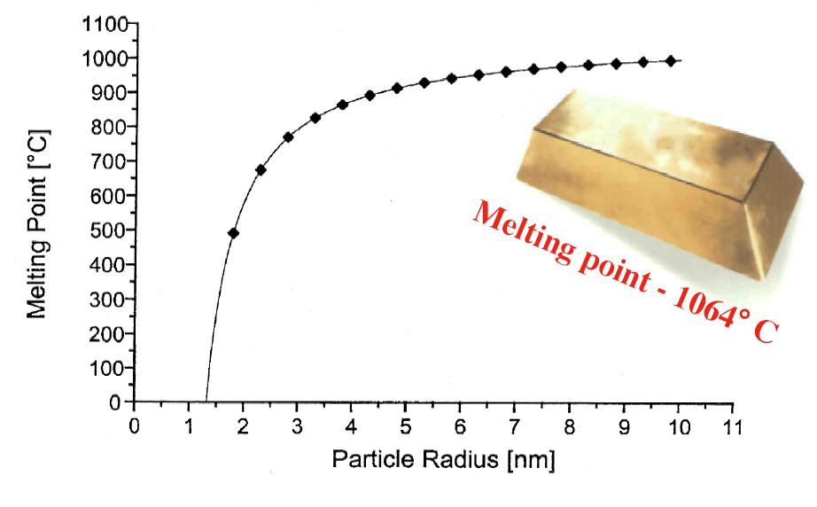
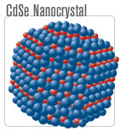

Physical/chemical properties can change as we approach the nano-scale
Melting point of gold particles
Fluorescence of semiconductor
nanocrystals
Decreasing crystal size
K. J. Klabunde, 2001
M. Bawendi, MIT: web.mit.edu/chemistry/nanocluster
Evident, Inc.: www.evidenttech.com
By controlling nano-scale (1) composition, (2) size, and (3) shape, we can create new materials with new properties 🡪 New technologies
*
14

Slide 15
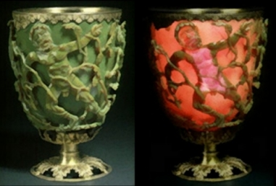
The Lycurgus Cup A Roman Nanotechnology
Reflected, transmitted
The Lycurgus Cup represents one of the outstanding achievements of the ancient glass industry. This late Roman cut glass vessel is extraordinary in several respects, firstly in
the method of fabrication and the exceptional workmanship involved and secondly in terms of the unusual optical effects displayed by the glass.
Chemical analysis showed the glass to be of the soda-lime-silica type, similar to most other Roman glass (and to modern window and bottle glass) containing in addition about 0.5% of manganese. In addition, a number of trace elements including silver and gold make up the final 1%. It was further suggested that the unique optical characteristics of the glass might be connected with the presence in the glass of colloidal gold

Slide 16
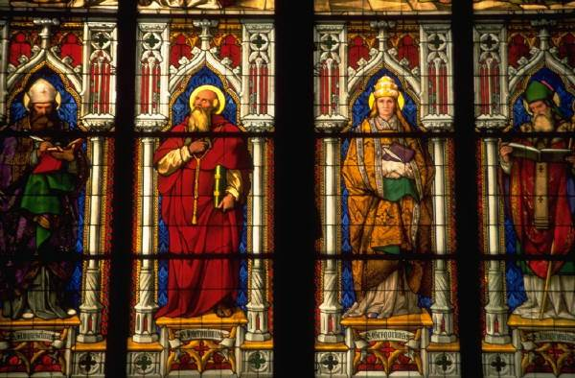
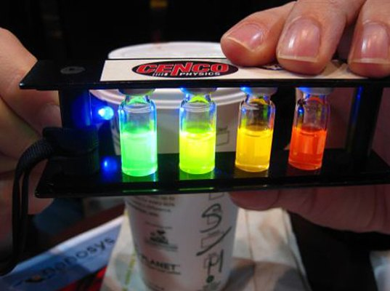

Slide 17
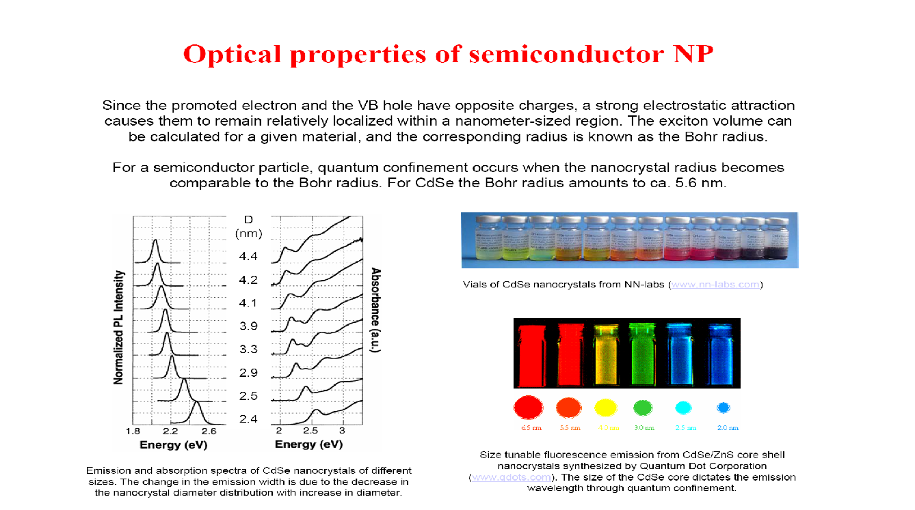
*
17

Slide 18
The semiconductors like PbS, GaAs, CdS etc., can be synthesized in the nanometer level and they are called as semiconductor quantum dots. Their properties like band gap, luminescence etc., always differs from their bulk counterpart. The quantum structures are useful in the fabrication of high efficiency solar cells, infrared detectors, quantum dot lasers etc.
Properties of Nanomaterials Unique properties They have very high magneto resistance They have lower melting point, high solid state phase transition pressure, lower Debye temperature and high self diffusion coefficient They have high catalytic activity and lower ferroelectric
phase transition temperature
18
Notes:
UNIT IV Nanomaterials & Nanotechnlogy
18

Slide 19
Variation of physical properties with size It is well established that mechanical, electrical, optical, chemical, semi conducting and magnetic properties of a material depend strongly upon the size and the arrangement of the constituent clusters or grains.
(i) Electron affinities and chemical properties
Variation in electronic properties with size occurs only when there is a variation in inter particle spacing and geometry. As the size is reduced from the bulk, the electronic bands in metals become narrower and the delocalized electronic states are transformed to more localized molecular bonds.
19
Notes:
UNIT IV Nanomaterials & Nanotechnlogy
19

Slide 20
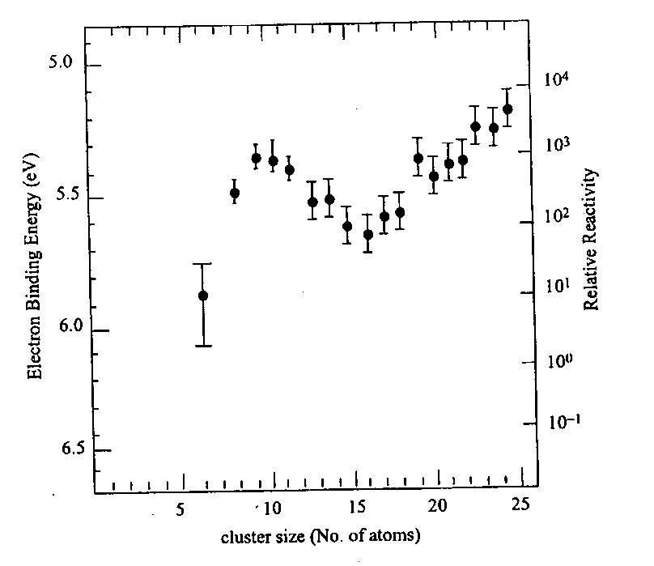
Variation in electronic properties with size occurs only when there is a variation in inter particle spacing and geometry. As the size is reduced from the bulk, the electronic bands in metals become narrower and the delocalized electronic states are transformed to more localized molecular bonds.
Fig shows the ionization potential and reactivity of Fen clusters as a function of size.
The ionization potential are higher at smaller sizes than at the bulk work function .
The large surface – to – volume ratio and the variation in geometry and electronic structure have a strong effect on catalysis properties.
Ionization potential and reactivity of Fen clusters as a function of size
20
Notes:
UNIT IV Nanomaterials & Nanotechnlogy
20

Slide 21
(ii) Magnetic properties
Nano particles of magnetic and even non magnetic solids exhibit a totally new class of magnetic properties.
Table gives an account of magnetic behavior of very small particles of various metals.
Ferro magnetic and anti ferromagnetic multilayers have been found to exhibit Giant Magneto Resistance (GMR).
Small particles differ from the bulk in that these atoms will have lower
co-ordination number.
From the Fig, it is inferred that the small particles are more
magnetic than the bulk material
Metal | Bulk | Cluster
Na, K | Paramagnetic | Ferromagnetic
Fe, Co, Ni | Ferro magnetic | Super paramagnetic
Gd, Tb | Ferromagnetic | Super paramagnetic
Rh | Paramagnetic | Ferromagnetic
Table Magnetism in bulk and in nano particles
21
Notes:
UNIT IV Nanomaterials & Nanotechnlogy
21

Slide 22
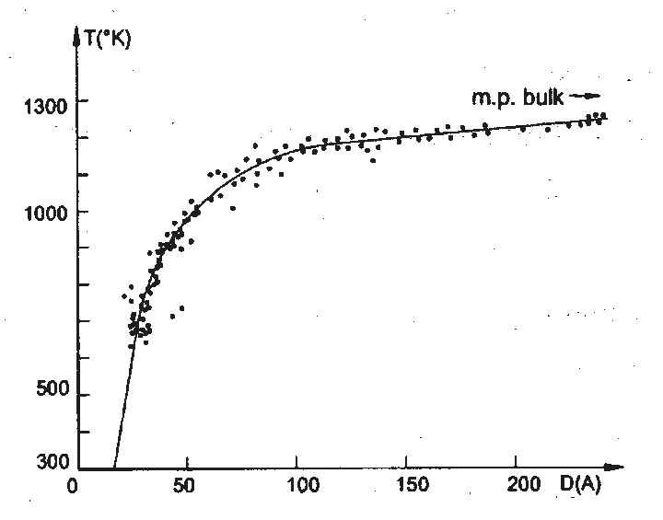
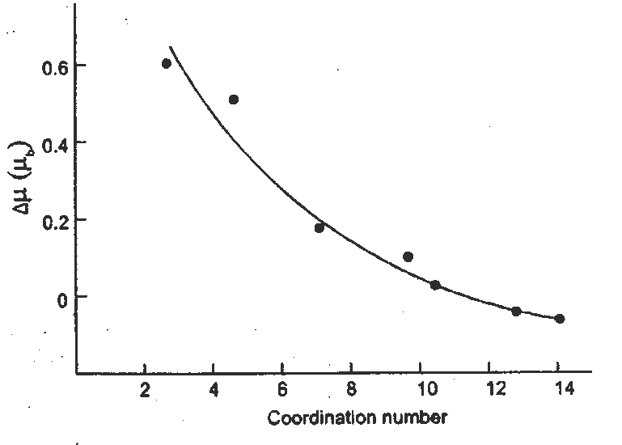
Change in bulk magnetic moment versus co- ordination number
Melting point of gold as a function of
grain size
(iii) Mechanical behaviour
From the Fig. it is evident that the melting point reduction is not really significant until the particle size is less than about 10nm.
22

Slide 23
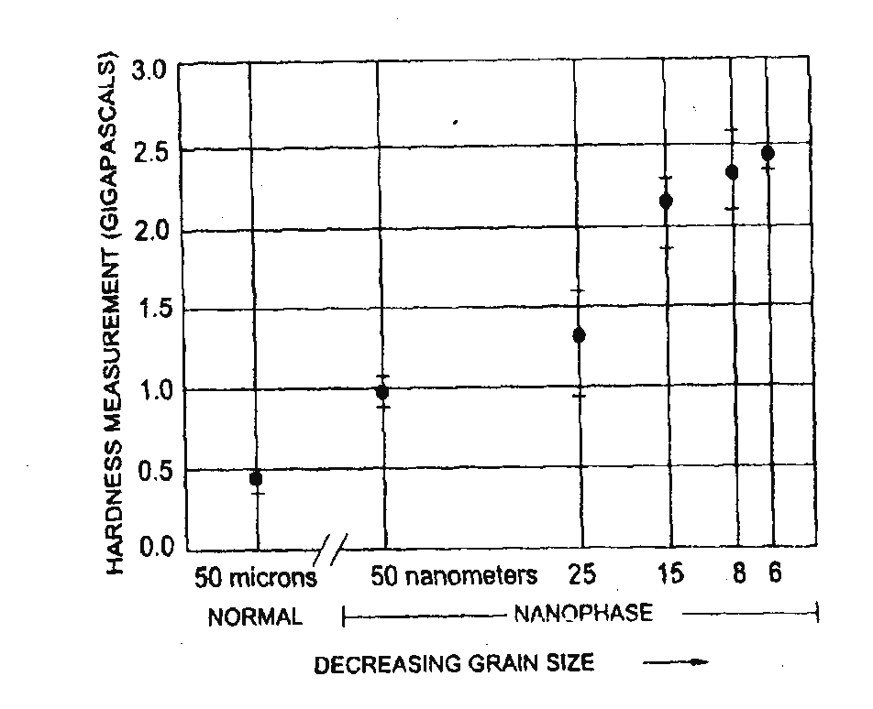
Nanophase metals with their exceptionally small grain size are found to be exceptionally strong.
It is because clusters and grains in nanophase material are mostly free from dislocations.
The variation of hardness with diameter of copper nano crystals is shown in Fig.
From the Fig. it is revealed that when the grains size was 50nm in diameter, the copper was twice as hard as usual.
Thus the material in nano phase has very high strength and super hardness.
Fig. Strength of nanophase copper as a function of grain size
23

Slide 24
The basic principles of nanotechnology is positional control.
At the macroscopic scale, it is easy to hold parts in our hands and assemble them by properly positioning them with respect to each other.
At the molecular scale, the idea of holding and positioning molecules is new and almost shocking.
It is possible to continue the revolution in computer hardware right down to molecular gates and wires -- something that today's lithographic methods (used to make computer chips) could never hope to do.
One can inexpensively make very strong and very light materials: shatterproof diamond in precisely the shapes we want, by the ton, and over fifty times lighter than steel of the same strength.
It is possible to make surgical instruments with high precision and deftness that one could operate on the cells and even molecules from which we are made - something well beyond today's medical technology
Nanotechnology makes almost every manufactured product faster, lighter, stronger, smarter, safer and cleaner.
24

Slide 25
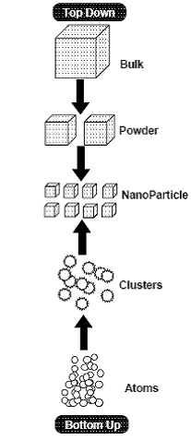
The general synthetic path ways to synthesize nanomaterials are top-down and bottom-up approach
In the later method, chemistry plays a unique role in assembling and building up nanometric units from smaller ones.

Slide 26
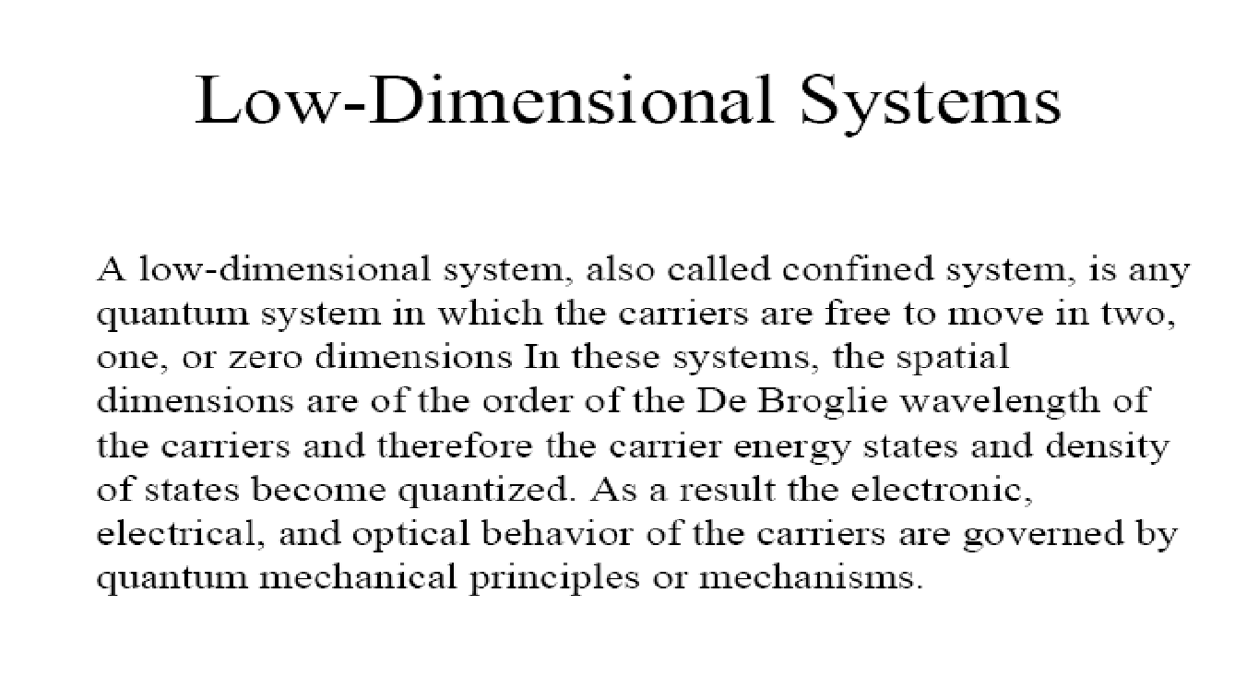
Electrical Measurements:
Measurements of electrical quantities, such as voltage, impedance, current, AC frequency and phase, power, electric energy, electric charge, inductance, and capacitance
Electrical measurements are among the most widely performed types of measurement.
The resistivity measurements can be studied by different techniques
26
Notes:
26

Slide 27
Classification
Classification is based on the number of dimensions, which are
not confined to the nanoscale range (<100 nm).
(1) zero-dimensional (0-D), (spherical)
(2) one-dimensional (1-D), (nanorods, nanowires, nanofibers, nanotubes)
(3) two-dimensional (2-D), and (flat membranes, nanosheets, nanodisc)
(4) three-dimensional (3-D). (nanodots)

Slide 28
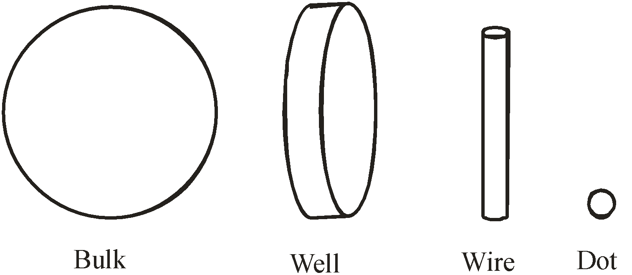
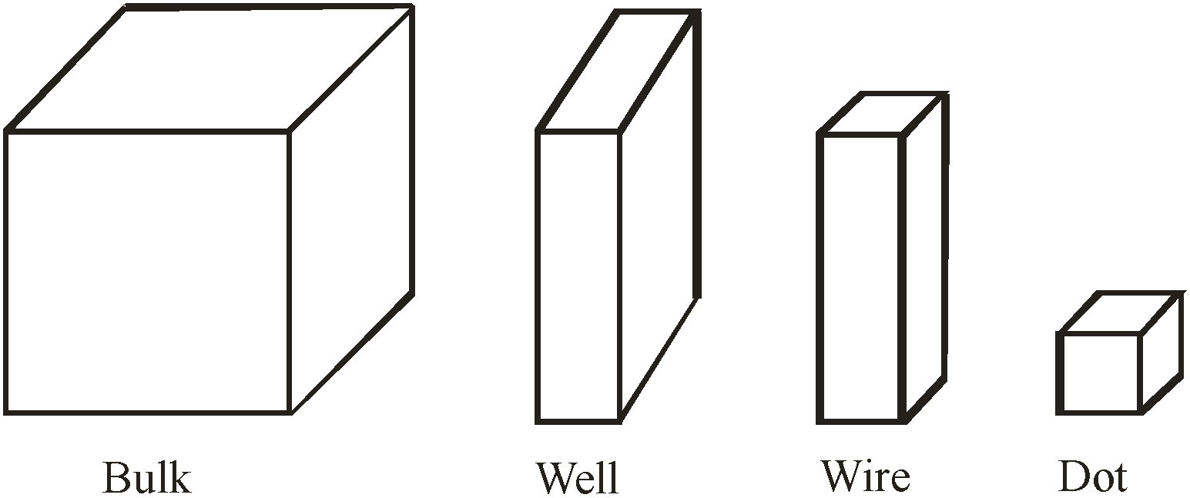
Progressive generation of nanostructures
Well : - e-s move only in 2D
Wire : - only in 1 D
Dots: - confined in all directions, 3D. No movement
quanta means "how much"
curvilinear
rectangular
Nanomaterials:
Nanomaterials or nanophase materials are the materials which are made of grains that are about 100nm in diameter and contain less than few ten thousands of atoms
*
28

Slide 29
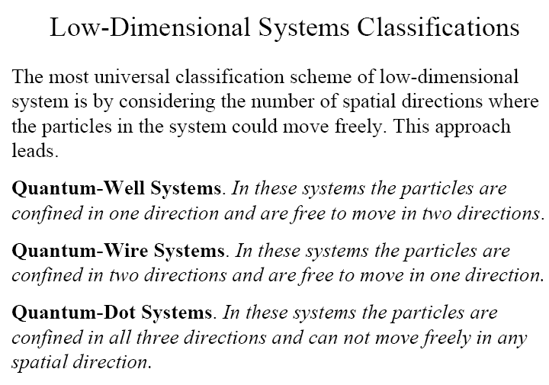
29

Slide 30
Quantum well, Quantum wire and Quantum dots
When the size or dimension of a material is continuously reduced from a large or macroscopic size, such a metre or centimetre, to a very small size, the properties remain the same at first, then small changes begin to occur, until finally when the size drops below100 nm, dramatic changes in properties can occur.
If one dimension is reduced to the nanorange while the other dimensions remain large, them we obtain a structure known as quantum well.
If two dimensions are so reduced and one remains large, the resulting structure is referred to as a quantum wire.
The extreme case of this process of size reduction in which all three dimensions reach the low nanometer range is called a quantum dot.
30
Notes:
UNIT IV Nanomaterials & Nanotechnlogy
30

Slide 31
The word quantum is associated with the above three types of nanostructures because the changes in properties arise from the quantum mechanical nature of physics in the domain of the ultra small. The above fig. represents the processes of diminishing the size for the case of rectilinear geometry and the corresponding reductions in curvilinear geometry. The conduction electrons are confined in a narrow dimension and such a configuration is referred as quantum well. A quantum wire is a structure such as a copper wire that is long in one dimension, but has a nanometer size as its diameter. In this case, the electrons move freely along the wire but are confined in the transverse directions. The quantum dot may have the shape of a tiny cube, a short cylinder or a sphere with low nanometre dimensions.
31
Notes:
UNIT IV Nanomaterials & Nanotechnlogy
31

Slide 32

TECHNOLOGICAL ADVANTAGES OF NANOTECHNOLOGY AND NANOMATERIALS
IMPROVED TRANSPORTATION
Today, most airplanes are made from metal despite the fact that diamond has a strength-to-weight ratio over 50 times that of aerospace aluminum.
Diamond is expensive, it is not possible to make it in the required shapes, and it shatters. Nanotechnology will let us inexpensively make shatterproof diamond in exactly the shapes we want.
Nanotechnology will dramatically reduce the costs and increase the capabilities of space ships and space flight.
The strength-to-weight ratio and the cost of components are absolutely critical to the performance and economy of space ships: with nanotechnology, both of these parameters will be improved.
Nanotechnology will also provide extremely powerful computers
with which to guide both those ships and a wide range of other activities in space.
32

Slide 33
2. ATOM COMPUTERS
Today, computer chips are made using lithography -- literally, "stone writing."
If the computer hardware revolution is to continue at its current pace, in a decade or so we'll have to move beyond lithography to some new post lithographic manufacturing technology. Ultimately, each logic element will be made from just a few atoms.
Designs for computer gates with less than 1,000 atoms have already been proposed -- but each atom in such a small device has to be in exactly the right place.
To economically build and interconnect trillions upon trillions of such small and precise devices in a complex three dimensional pattern we'll need a manufacturing technology well beyond today's lithography: we'll need nanotechnology.
With it, we should be able to build mass storage devices that can store more than a hundred billion billion bytes in a volume the size of a sugar cube;
RAM that can store a mere billion billion bytes in such a volume; and massively parallel computers of the same size that can deliver a billion billion instructions per second.
33

Slide 34
3. MILITARY APPLICATIONS:
Today, "smart" weapons are fairly big -- we have the "smart bomb" but not the "smart bullet.“
In the future, even weapons as small as a single bullet could pack more computer power than the largest supercomputer in existence today, allowing them to perform real time image analysis of their surroundings and communicate with weapons tracking systems to acquire and navigate to targets with greater precision and control.
We'll also be able to build weapons both inexpensively and much more rapidly, at the same time taking full advantage of the remarkable materials properties of diamond.
Rapid and inexpensive manufacture of great quantities of stronger more precise weapons guided by massively increased computational power will alter the way we fight wars.
Changes of this magnitude could destabilize existing power structures in unpredictable ways.
Military applications of nanotechnology raise a number of concerns that prudence suggests we begin to investigate before, rather than after, we develop this new technology.
34
Notes:
UNIT IV Nanomaterials & Nanotechnlogy
34

Slide 35
4. SOLAR ENERGY Nanotechnology will cut costs both of the solar cells and the equipment needed to deploy them, making solar power economical. In this application we need not make new or technically superior solar cells: making inexpensively what we already know how to make expensively would move solar power into the mainstream.
5. MEDICAL USES
It is not modern medicine that does the healing, but the cells themselves: we are but onlookers.
If we had surgical tools that were molecular both in their size and precision, we could develop a medical technology that for the first time would let us directly heal the injuries at the molecular and cellular level that are the root causes of disease and ill health.
With the precision of drugs combined with the intelligent guidance of the surgeon's scalpel, we can expect a quantum leap in our medical capabilities.
35
Notes:
UNIT IV Nanomaterials & Nanotechnlogy
35

Slide 36
6. Other Advantages Less Pollution The problem with past technologies is that they pollute the environment in cases where we humans would die in years. A good example of a bad polluting invention would be the automobile. The automobile ran on gas and the gas fumes destroyed the ozone layer.
36
Notes:
UNIT IV Nanomaterials & Nanotechnlogy
36

